Slide 1
More Q-Learning
Scott O’Hara
Metrowest Developers Machine Learning Group
11/14/2018

Slide 2
References
University of California, Berkeley CS188:
CS188 – Introduction to Artificial Intelligence, Profs. Dan Klein, Pieter Abbeel, et al. http://ai.berkeley.edu/home.html
David Silver, DeepMind:
Introduction to Reinforcement Learning http://www0.cs.ucl.ac.uk/staff/d.silver/web/Teaching.html
CS181 course at Harvard University:
CS181 Intelligent Machines: Perception, Learning and Uncertainty, Sarah Finney, Spring 2009
CS181 Intelligent Machines: Perception, Learning and Uncertainty, Prof. David C Brooks, Spring 2011
CS181 – Machine Learning, Prof. Ryan P. Adams, Spring 2014. https://github.com/wihl/cs181-spring2014
CS181 – Machine Learning, Prof. David Parkes, Spring 2017. https://harvard-ml-courses.github.io/cs181-web-2017/
The material for this talk is primarily drawn from the slides, notes and lectures of these courses:

Slide 3
overview
Where We Have Been
Reinforcement Learning Overview
Markov Decision Processes (MDPs)
4 MDP Algorithms
Reinforcement Learning
Model-based RL
Model-free RL: Q-Learning
More Q-Learning
Q-Learning Demos
Approximate Q-Learning

Slide 4
Reinforcement Learning overview

Slide 5
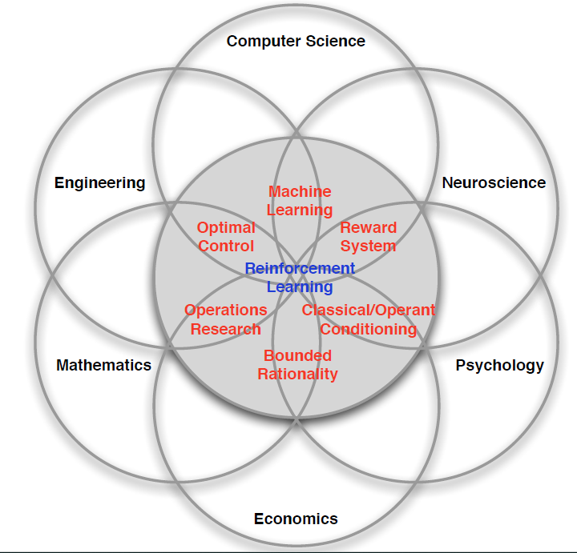
Many Faces of Reinforcement Learning
Credit: adapted from lecture slides David Silver, DeepMind, “Introduction to Reinforcement Learning

Slide 6
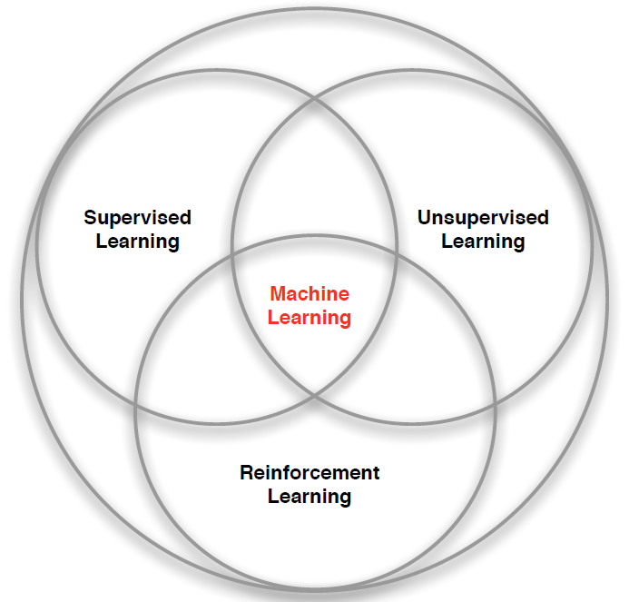
branches of Machine Learning
Credit: adapted from lecture slides David Silver, DeepMind, “Introduction to Reinforcement Learning

Slide 7
Characteristics of Reinforcement Learning
There is no supervisor, only a reward signal
Feedback is delayed, not instantaneous
Time really matters (sequential, data is not i.i.d. – independent and identically distributed.)
Agent’s actions affect the subsequent data it receives.
Credit: adapted from lecture slides David Silver, DeepMind, “Introduction to Reinforcement Learning

Slide 8
Examples of Reinforcement Learning
Fly stunt maneuvers in a helicopter
Defeat the world champion at Backgammon
Manage an investment portfolio
Control a power station
Make a humanoid robot walk
Play Atari games better than humans
Credit: adapted from lecture slides David Silver, DeepMind, “Introduction to Reinforcement Learning

Slide 9
Examples of Reinforcement Learning
RL Course by David Silver – Lecture1: Introduction to Reinforcement Learning
https://www.youtube.com/watch?v=2pWv7GOvuf0
12:25 – 22.00
Credit: adapted from lecture slides David Silver, DeepMind, “Introduction to Reinforcement Learning

Slide 10
Markov decision processes

Slide 11
Markov decision processes
Markov Decision Processes provide a mathematical framework for modeling decision making in situations where outcomes are partly random and partly under the control of a decision maker.
The initial analysis of MDPs assume complete knowledge of states, actions, rewards, transitions, and discounts.
<https://en.wikipedia.org/w/index.php?title=Markov_decision_process&oldid=855934986> [accessed 11 September 2018]

Slide 12
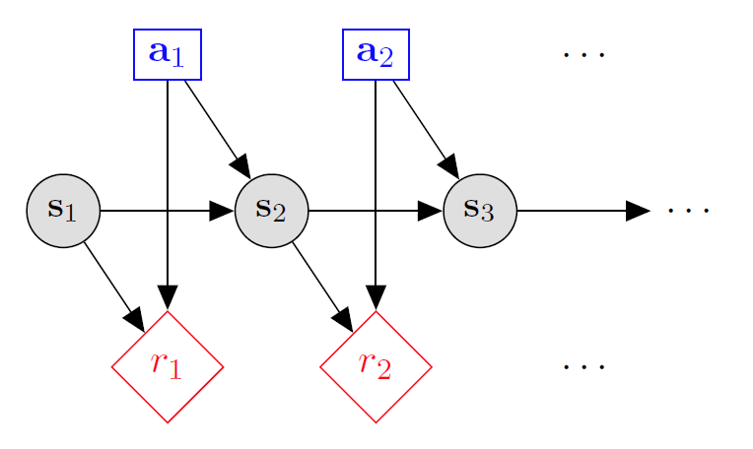

Markov decision processes
States: $s_{1},…,s_{n}$
Actions: $a_{1},…,a_{m}$
Reward Function:
$r\left(s,a,s′\right)∈R$
Transition model:
T(s,a,s’)= $P\left(s′ | s, a\right)$
Discount factor: $γ∈\left[0,1\right]$
<https://en.wikipedia.org/w/index.php?title=Markov_decision_process&oldid=855934986> [accessed 11 September 2018]

Slide 13





Example: Grid World
A maze-like problem
The agent lives in a grid
Walls block the agent’s path
Noisy movement: actions do not always go as planned
80% of the time, the action North takes the agent North (if there is no wall there)
10% of the time, North takes the agent West; 10% East
If there is a wall in the direction the agent would have been taken, the agent stays put
The agent receives rewards each time step
Small “living” reward each step (can be negative)
Big rewards come at the end (good or bad)
Goal: maximize sum of rewards
Credit: CS188 – Intro to AI, UC Berkeley, ai.berkely.edu
Notes:
[cut demo of moving around in grid world program]

Slide 14
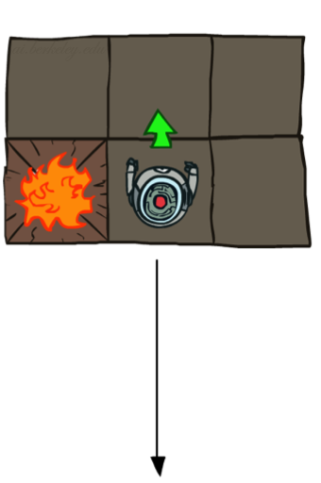
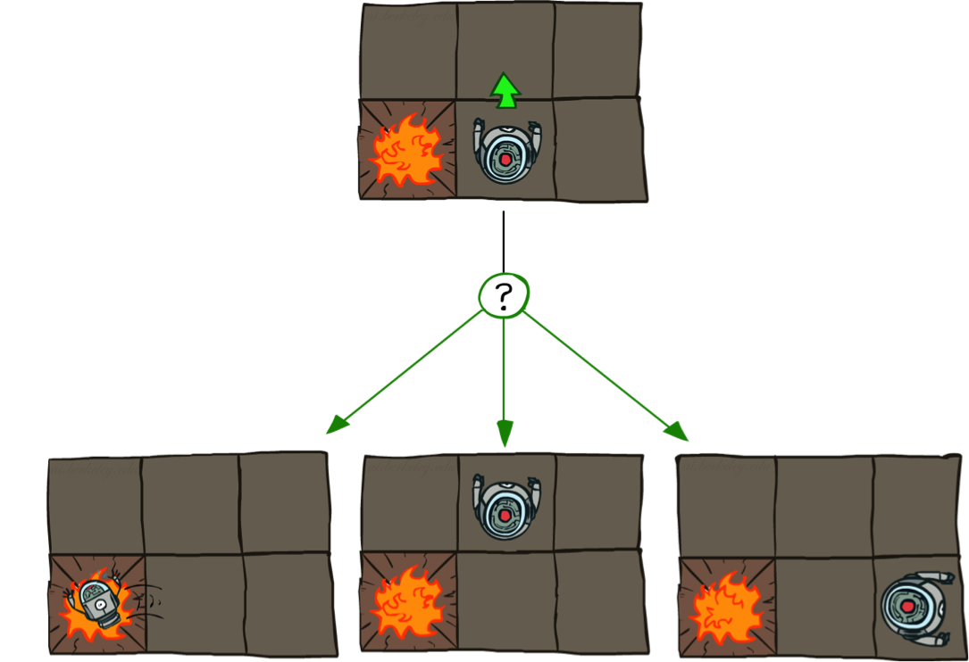

Grid World Actions
Deterministic Grid World
Stochastic Grid World
Credit: CS188 – Intro to AI, UC Berkeley, ai.berkely.edu

Slide 15

What is Markov about MDPs?
“Markov” generally means that given the present state, the future and the past are independent
For Markov decision processes, “Markov” means action outcomes depend only on the current state
This is just like search, where the successor function only depends on the current state (not the history)
=
Andrey Markov (1856-1922)
Credit: CS188 – Intro to AI, UC Berkeley, ai.berkely.edu
Notes:
Like search: successor function only depended on current state
Can make this happen by stuffing more into the state;
Very similar to search problems: when solving a maze with food pellets, we stored which food pellets were eaten

Slide 16

MDP Goal: find an optimal policy π
In search problems, we look for an optimal plan, or sequence of actions, from start to a goal
For MDPs, we want an optimal policy π*: S → A
A policy π gives an action for each state
An optimal policy is one that maximizes expected utility if followed
Credit: CS188 – Intro to AI, UC Berkeley, ai.berkely.edu
Notes:
Dan has a DEMO for this.

Slide 17

Optimal Policies
R(s) = 0.05
R(s) = 0.0
R(s) = -0.01
R(s) = -2.0
Notes:
R(s) = the “living reward”

Slide 18
4 MDP Algorithms

Slide 19
4 mdp algorithms
Assume complete knowledge of the MDP
Make use of the Bellman Equations
Expectimax (recursive, finite horizon)
Value Iteration (dynamic programming, finite horizon)
Value Iteration (dynamic programming, infinite horizon)
Policy Iteration (dynamic programming, infinite horizon,
optimize policy)

Slide 20
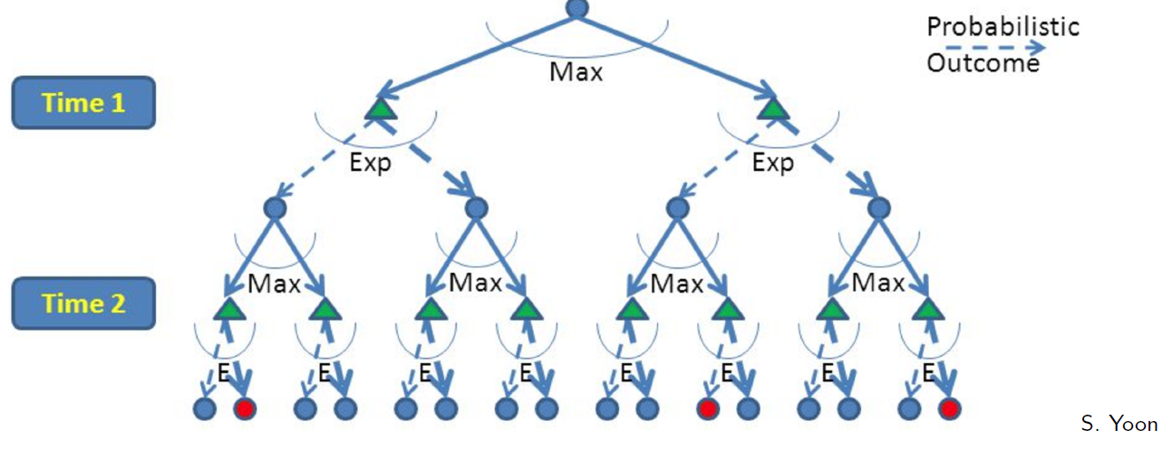
Expectimax: A game against Nature
Expectimax is like a game-playing algorithm except the opponent is nature.
Expectimax is strongly related to the minmax algorithm used in game theory, but the response is probabilistic.
Nodes where you move are called states: S ( )
Nodes where nature moves are called Q-states: <S,A> ( )
Credit: CS188 – Intro to AI, UC Berkeley, ai.berkely.edu

Slide 21
Optimal Quantities
The value (utility) of a state s:
V*(s) = expected utility starting in s and acting optimally
The value (utility) of a q-state (s,a):
Q*(s,a) = expected utility starting out having taken action a from state s and (thereafter) acting optimally
The optimal policy:
π*(s) = optimal action from state s
s
s is a state
a
(s, a) is a q-state
s, a
s,a,s’
(s,a,s’) is a transition
s’
Credit: CS188 – Intro to AI, UC Berkeley, ai.berkely.edu
Notes:
Demo just shows V and Q values, snapshots on next slides.

Slide 22



The Bellman Equations
There is one equation $V^{∗}(s)$ for each state s.
There is one equation $Q^{∗}(s,a)$ for each state s and action a.
These are equations, not assignments. They define a relationship, which when satisfied guarantees that $V^{∗}(s)$ and $Q^{∗}\left(s,a\right)$ are optimal for each state and action.
This in turn guarantees that the policy $π^{∗}$is optimal.
s
a
s, a
s,a,s’
s’
Credit: CS188 – Intro to AI, UC Berkeley, ai.berkely.edu
Credit: CS181 – Machine Learning, D. Parkes, Harvard Univ, Spring 2017
Notes:
Let’s start by equations that characterize these quantities through mutual recursions. [step through this by writing on slide, one step at a time]
Recursive characterization of V* in terms of V*; not necessarily helpful; but it is a characterization.
Note: this is a set of equations that needs to be satisfied; but it could have multiple solutions (it does not, but at this stage of our knowledge it could).

Slide 23
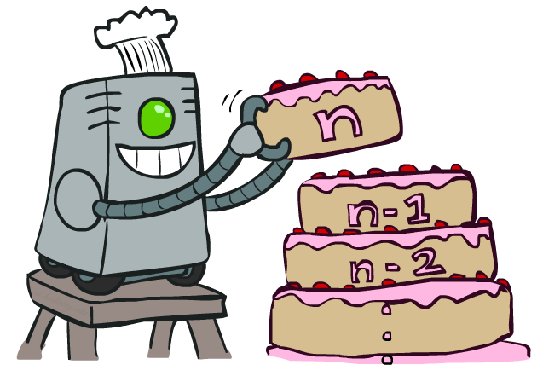
Value Iteration uses dynamic programming
Credit: CS188 – Intro to AI, UC Berkeley, ai.berkely.edu

Slide 24
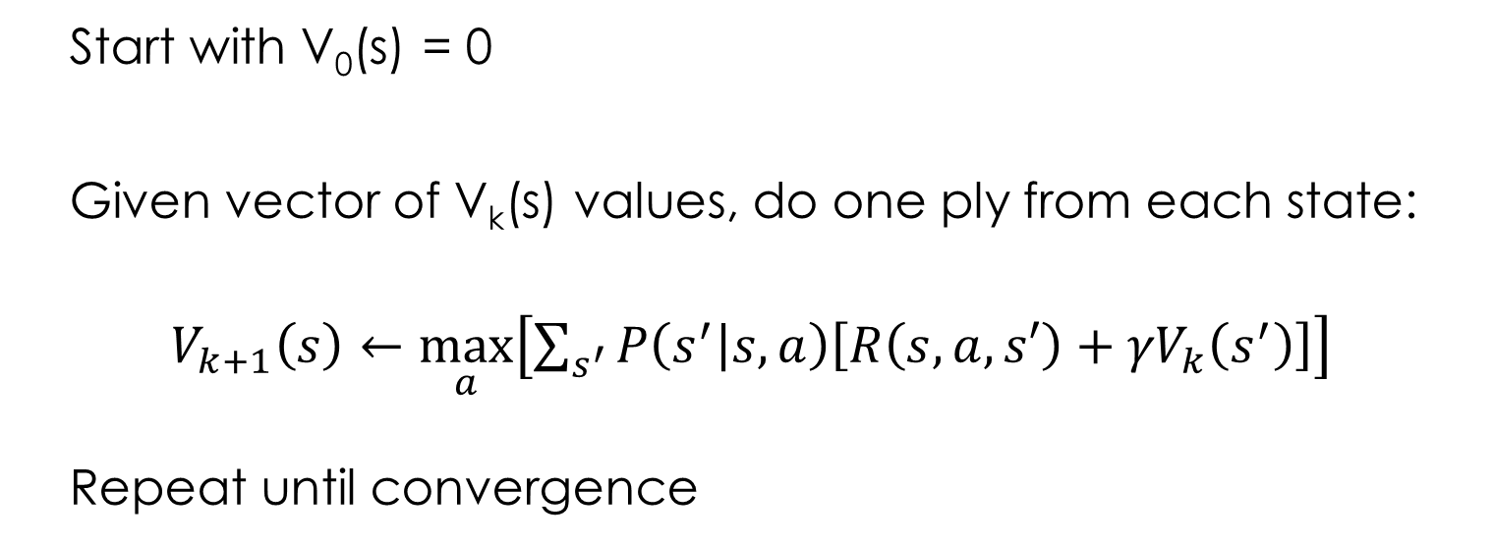
Value Iteration
V_{k+1}(s)
Start with V₀(s) = 0 - no time steps left means an expected reward sum of zero
Given vector of V_{k}(s) values, do one ply from each state:
$V_{k+1}\left(s\right)←\max_{a}\left[\sum_{s^{′}}{P\left(s^{′} | s,a\right)\left[R\left(s,a,s′\right)+{γV}_{k}\left(s^{′}\right)\right]}\right]$
Repeat until convergence
a
s, a
s,a,s’
V_{k}(s’)
Credit: CS188 – Intro to AI, UC Berkeley, ai.berkely.edu
Notes:
Discuss computational complexity: S * A * S times number of iterations
Note: updates not in place [if in place, it means something else and not even clear what it means]

Slide 25
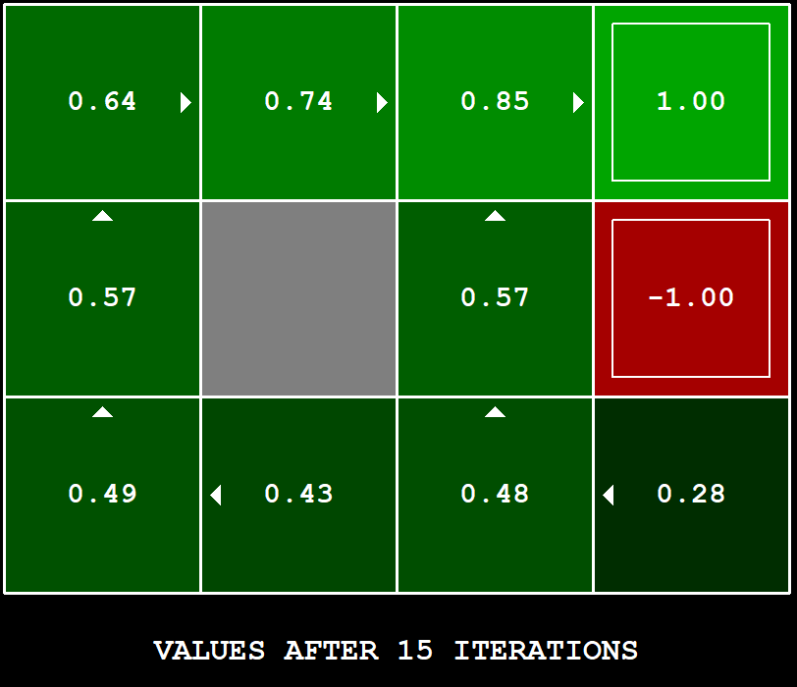
Value Iteration Example: gridworld
Credit: CS188 – Intro to AI, UC Berkeley, ai.berkely.edu
Notes:
python gridworld.py -k 40 -w 200 -s 0.25 -i 15 -a value -p -v
OPTIONS:
-h show this help message and exit
-d D discount on future (default 0.9)
-r reward for living for a time step (default 0.0)
-n P how often action results in unintended direction (default 0.2)
-e E chance of taking a random action in q-learning (default 0.3)
-l P TD learning rate (default 0.5)
-i R number of rounds of value iteration (default 10)
-k K number of episodes of the MDP to run (default 1)
-g G grid to use (case sensitive; options are: BookGrid, BridgeGrid,
CliffGrid, CliffGrid2, MazeGrid, SmallGrid, MediumGrid, default BookGrid)
-w X request a window width of X pixels *per grid cell* (default 150)
-a A agent type (options are 'random', 'value' and 'q', default random)
-t use text-only ASCII display
-p pause GUI after each time step when running the MDP
-q skip display of any learning episodes
-s S speed of animation, S > 1.0 is faster, 0.0 < S < 1.0 is slower (default 1.0)
-m manually control agent
-v display each step of value iteration

Slide 26
Policy Iteration
Step 1: Policy Evaluation: For fixed current policy π, find values with policy evaluation:
Iterate until values converge:
Step 2: Improvement: For fixed values, get a better policy using policy extraction:
One-step look-ahead:

Slide 27
Reinforcement Learning

Slide 28
Reinforcement Learning: the basic idea
Select an action
If action leads to reward, reinforce that action
If action leads to punishment, avoid that action
Basically, a computational form of Behaviorism (Pavlov, B. F. Skinner)

Slide 29
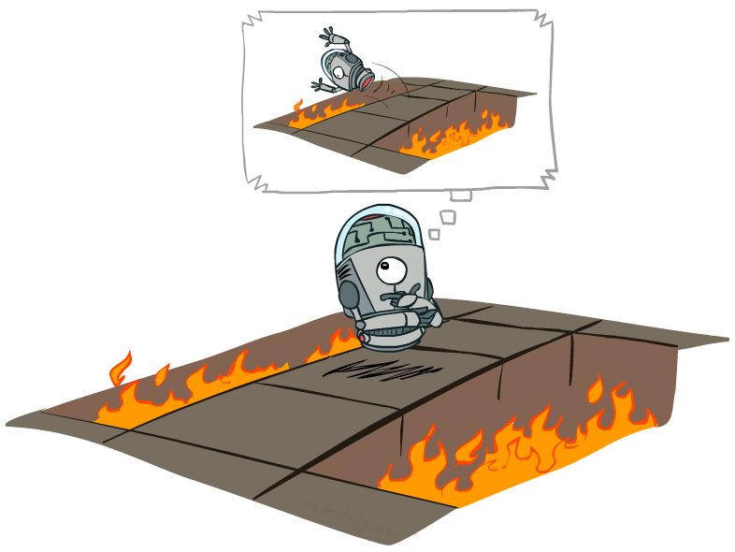
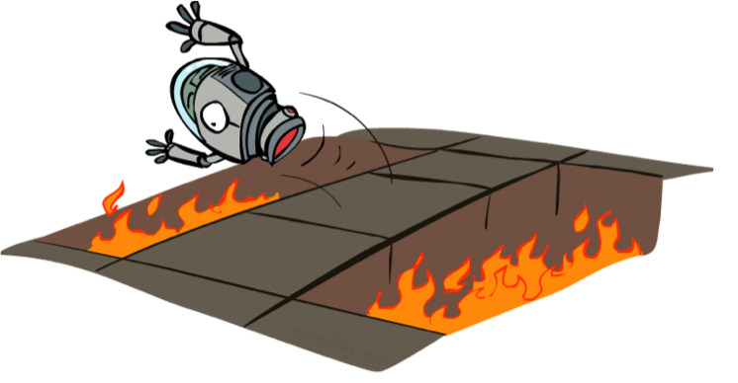
Offline vs. Online
Offline Learning
Online Learning

Slide 30
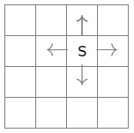
the Learning framework
Learning is performed online, learn as we interact with the world
In contrast with supervised learning, there are no training or test sets. The reward is accumulated over interactions with the environment.
Data is not fixed, more information is acquired as you go.
The training distribution can be influenced by action decisions.

Slide 31
Reinforcement Learning
Actions: a
Agent
Environment
State: s’
Reward: r
Agent knows the current state s, takes action a, receives a reward r and observes the next state s’
Agent has no access to reward model r(s,a,s’) or the transition model p(s’|s,a)
Agent learn to act so as to maximize expected rewards.
All learning is based on observed samples of outcomes.

Slide 32
Model-based reinforcement learning

Slide 33

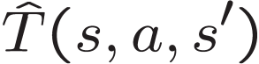

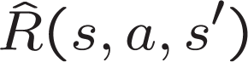
Model-Based Learning
Model-Based Idea:
Learn an approximate model based on experiences
Solve for values as if the learned model were correct
Step 1: Learn empirical MDP model
Count outcomes s’ for each s, a
Normalize to give an estimate of the transition model:
Discover the reward model when the robot experience(s, a, s’):
Step 2: Solve the learned MDP
For example, use value iteration or policy iteration
Repeat

Slide 34

Learn the reward and transition distributions
Try every action in each state a number of times
$RTotal\left(s,a,s^{′}\right)=$total reward for taking action a in state s and transitioning to state s’
$N\left(a,s\right)=$ number of times action a is taken in state s
$N\left(s,a,s^{′}\right)=$ number of times s transitions to s’ on action a
$\hat{R}\left(s,a,s^{′}\right)=RTotal(s,a,s^{′})/N(s,a,s^{′})$
$\hat{T}\left(s,a,s^{′}\right)=N(s,a,s^{′})/N(a,s)$

Slide 35
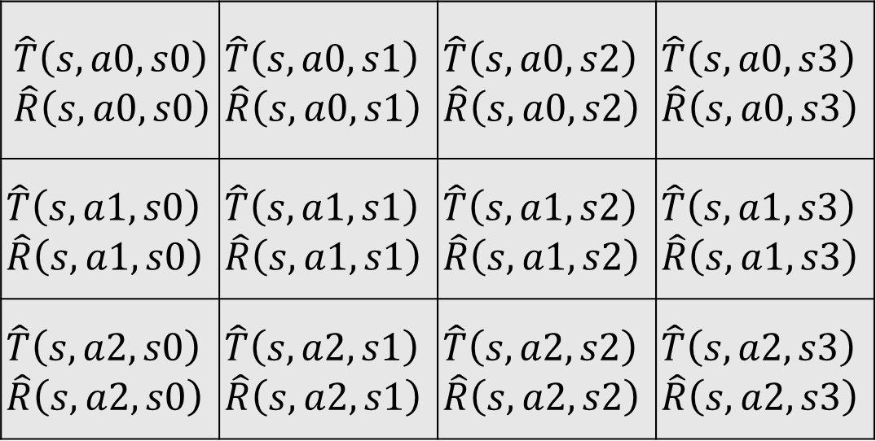
Transition/reward parameter table
For every state s:
State s’
$$\hat{T}\left(s,a0,s0\right)$$ $$\hat{R}\left(s,a0,s0\right)$$ | $$\hat{T}\left(s,a0,s1\right)$$ $$\hat{R}\left(s,a0,s1\right)$$ | $$\hat{T}\left(s,a0,s2\right)$$ $$\hat{R}\left(s,a0,s2\right)$$ | $$\hat{T}\left(s,a0,s3\right)$$ $$\hat{R}\left(s,a0,s3\right)$$
$$\hat{T}\left(s,a1,s0\right)$$ $$\hat{R}\left(s,a1,s0\right)$$ | $$\hat{T}\left(s,a1,s1\right)$$ $$\hat{R}\left(s,a1,s1\right)$$ | $$\hat{T}\left(s,a1,s2\right)$$ $$\hat{R}\left(s,a1,s2\right)$$ | $$\hat{T}\left(s,a1,s3\right)$$ $$\hat{R}\left(s,a1,s3\right)$$
$$\hat{T}\left(s,a2,s0\right)$$ $$\hat{R}\left(s,a2,s0\right)$$ | $$\hat{T}\left(s,a2,s1\right)$$ $$\hat{R}\left(s,a2,s1\right)$$ | $$\hat{T}\left(s,a2,s2\right)$$ $$\hat{R}\left(s,a2,s2\right)$$ | $$\hat{T}\left(s,a2,s3\right)$$ $$\hat{R}\left(s,a2,s3\right)$$
Action a

Slide 36
Model-based rl: Pros and cons
Pros:
Makes maximal use of experience
Solves model optimally, given enough experience
Cons:
Assumes model is small enough to solve
Requires expensive solution procedure

Slide 37
Model-free reinforcement learning: Q-Learning

Slide 38

Q-Learning
Don’t learn a model, learn the Q function directly
Appropriate when model is too large to store, solve or learn
size of transition of model: $O\left(\left|S^{2}\right|\right)$
value iteration cost: $O\left(\left|A\right|\left|S^{2}\right|\right)$
size of Q function $O\left(\left|A\right|\left|S\right|\right)$

Slide 39
Recall The Bellman Equations
s
a
s, a
s,a,s’
s’
Notes:
Let’s start by equations that characterize these quantities through mutual recursions. [step through this by writing on slide, one step at a time]
Recursive characterization of V* in terms of V*; not necessarily helpful; but it is a characterization.
Note: this is a set of equations that needs to be satisfied; but it could have multiple solutions (it does not, but at this stage of our knowledge it could).

Slide 40
From Value Iteration to Q-Value Iteration
Value iteration: find successive (depth-limited) values
Start with V₀(s) = 0, which we know is right
Given V_{k}, calculate the depth k+1 values for all states:
But Q-values are more useful, so compute them instead
Start with Q₀(s,a) = 0, which we know is right
Given Q_{k}, calculate the depth k+1 q-values for all q-states:

Slide 41
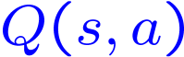
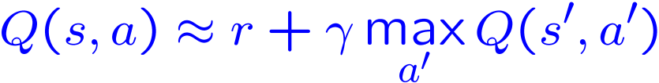
Q-Learning
Q-Learning: sample-based Q-value iteration
Learn Q(s,a) values as you go
Receive a sample transition (s,a,r,s’)
Consider your old estimate:
Consider your new sample estimate:
Incorporate the new estimate into a running average:

Slide 42

Q-Learning update rule
On transitioning from state s to state s’ on action a, and receiving reward r, update:
$α$ is the learning rate
a large $α$ results in quicker learning but may not converge.
$α$ is often decreased as learning goes on.
$γ$ is the discount rate i.e., discounts future rewards

Slide 43

Temporal difference (TD) learning
Q-Learning is an example of a more general approach to learning called Temporal Difference Learning
In TD learning, the general update is:
$NewEstimate←OldEstmate+StepSize[Target−OldEstimate]$
Rewrite Q-Learning update:
$$Q\left(s,a\right)←\left(1−α\right)Q(s,a)+α[r+γ\max_{a^{′}}{Q\left(s^{′},a^{′}\right)}]$$
$$Q\left(s,a\right)←Q(s,a)+α[(r+γ\max_{a^{′}}{Q\left(s^{′},a^{′}\right)})−Q\left(s,a\right)]$$
The idea is to repeatedly nudge the new estimate towards its learning target in each time period.

Slide 44
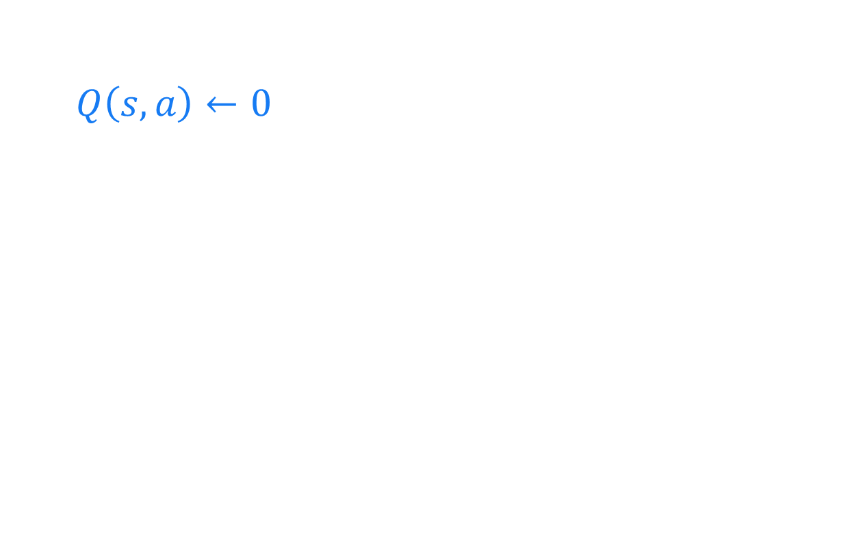
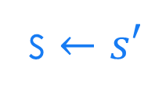
Q-Learning algorithm
For each state s and action a:
$Q\left(s,a\right)←0$
Begin in state s:
Repeat:
For all actions associated with state s, → CHOOSE ACTION a ← based on the Q values for state s
Receive reward r and transition to s’
s $←s′$

Slide 45
Choosing the Action
Learned Q function determines the policy
in state s, choose action with largest Q(s,a)
Still must worry about exploration vs. exploitation.
use techniques we discussed previously.

Slide 46
choosing an action: exploration vs exploitation
Exploit: use your current model to maximize the expected utility now.
Explore: choose an action that will help you improve your model.
How to Exploit? use the current policy.
How to Explore?
choose an action randomly
choose an action you haven’t chosen yet
choose an action that will take you to an unexplored state.

Slide 47


exploration strategy: $ε$-greedy
Explore with probability $ε.$ Exploit with probability $1−ε.$
Weaknesses:
Does not exploit when learning has converged.
Uses:
appropriate if the world is changing.

Slide 48

exploration strategy: Boltzmann
In state s, choose action a with probability p:
$$p=\frac{e^{\frac{Q(s,a)}{t}}}{\sum_{a′}{e^{\frac{Q(s,a′)}{t}}}}$$
Simulated annealing: t is a “temperature”
High temperature means more exploration
Over time, t cools, reducing exploration
Sensitive to cooling schedule.

Slide 49
Q-learning Demos

Slide 50
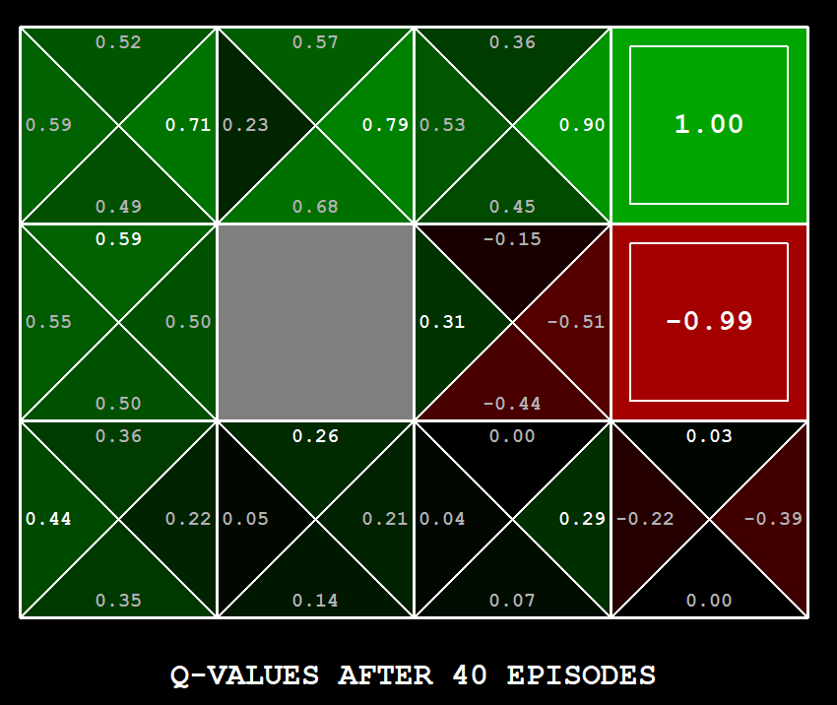
Q-Learning Example: gridworld
Notes:
python gridworld.py -k 40 -w 200 -s 2.0 -a q –v [-p]

Slide 51
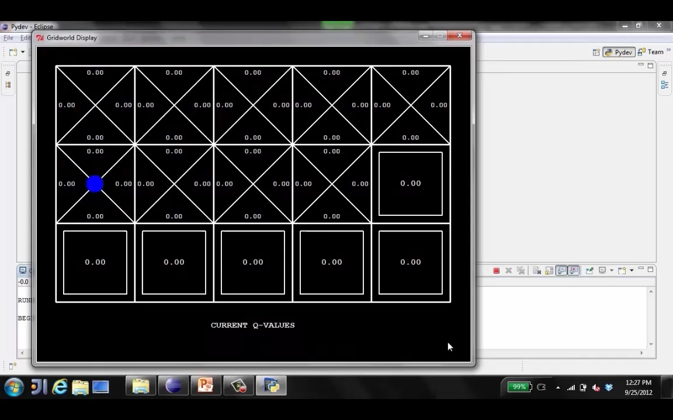
Video of Q-Learning demo -- Gridworld

Slide 52
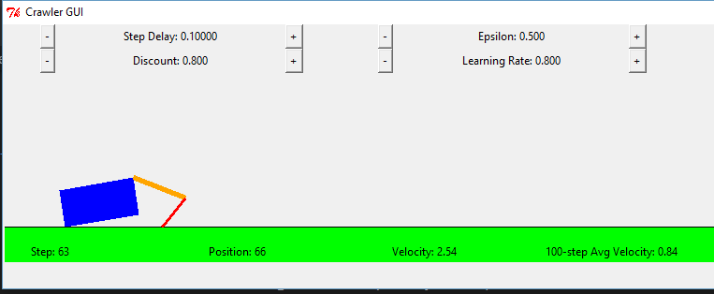
Q-Learning Example: Crawler Robot
Credit: CS188 – Intro to AI, UC Berkeley, ai.berkely.edu

Slide 53
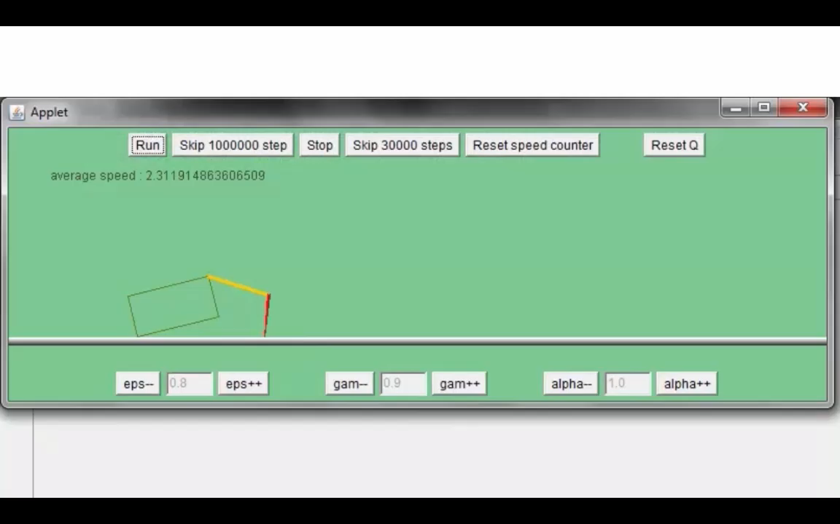
Video 1 of Q-Learning demo -- Crawler
Credit: CS188 – Intro to AI, UC Berkeley, ai.berkely.edu

Slide 54
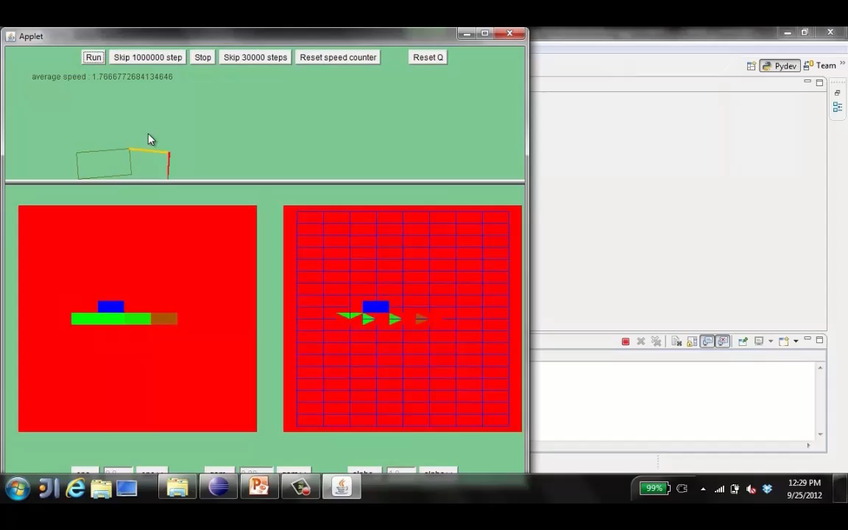
Video 2 of Q-Learning demo -- Crawler
Credit: CS188 – Intro to AI, UC Berkeley, ai.berkely.edu

Slide 55
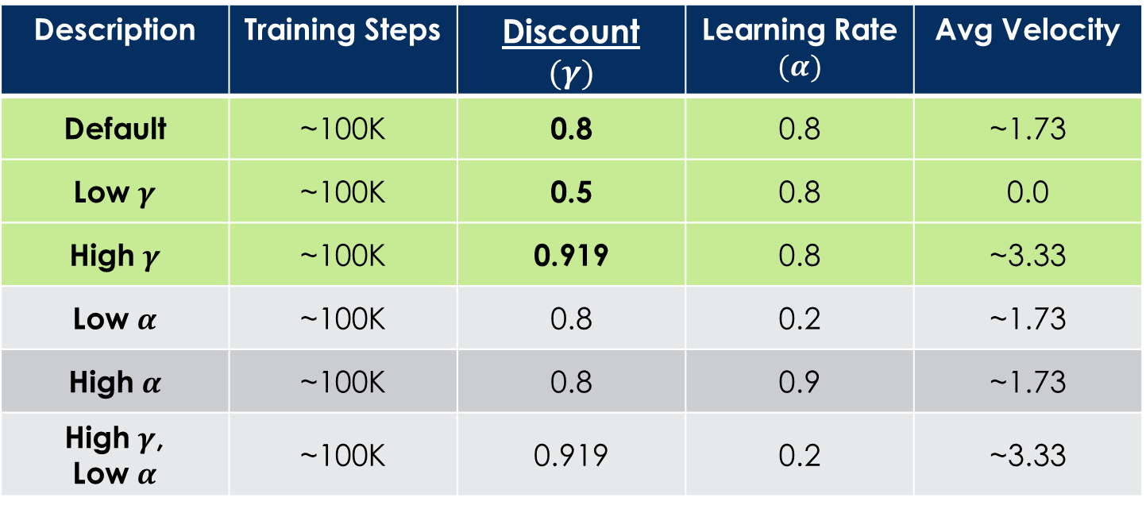
Q-Learning Example: discount effect
Update rule:
Description | Training Steps | Discount $$(γ)$$ | Learning Rate $$(α)$$ | Avg Velocity
Default | ~100K | 0.8 | 0.8 | ~1.73
Low $γ$ | ~100K | 0.5 | 0.8 | 0.0
High $γ$ | ~100K | 0.919 | 0.8 | ~3.33
Low $α$ | ~100K | 0.8 | 0.2 | ~1.73
High $α$ | ~100K | 0.8 | 0.9 | ~1.73
High $γ$, Low $α$ | ~100K | 0.919 | 0.2 | ~3.33

Slide 56

Q-Learning Properties
Amazing result: Q-learning converges to optimal policy -- even if you’re acting sub-optimally!
This is called off-policy learning
Caveats:
You have to explore enough
You have to eventually make the learning rate
small enough
… but not decrease it too quickly
Basically, in the limit, it doesn’t matter how you select actions (!)
Credit: CS188 – Intro to AI, UC Berkeley, ai.berkely.edu

Slide 57
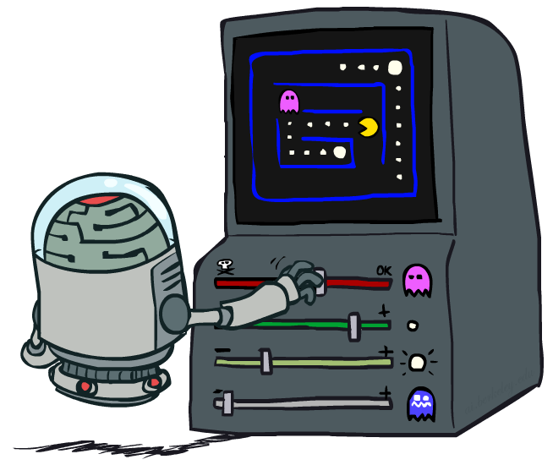
Approximate Q-Learning
Credit: CS188 – Intro to AI, UC Berkeley, ai.berkely.edu

Slide 58


Generalizing Across States
Basic Q-Learning keeps a table of all q-values
In realistic situations, we cannot possibly learn about every single state!
Too many states to visit them all in training
Too many states to hold the q-tables in memory
Instead, we want to generalize:
Learn about some small number of training states from experience
Generalize that experience to new, similar situations

Slide 59
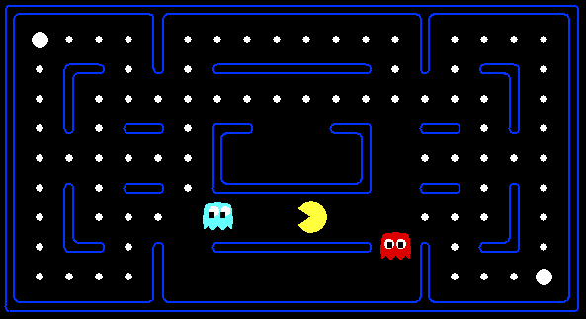



Example: Pacman
Let’s say we discover through experience that this state is bad:
In naïve q-learning, we know nothing about this state:
Or even this one!
Credit: CS188 – Intro to AI, UC Berkeley, ai.berkely.edu

Slide 60
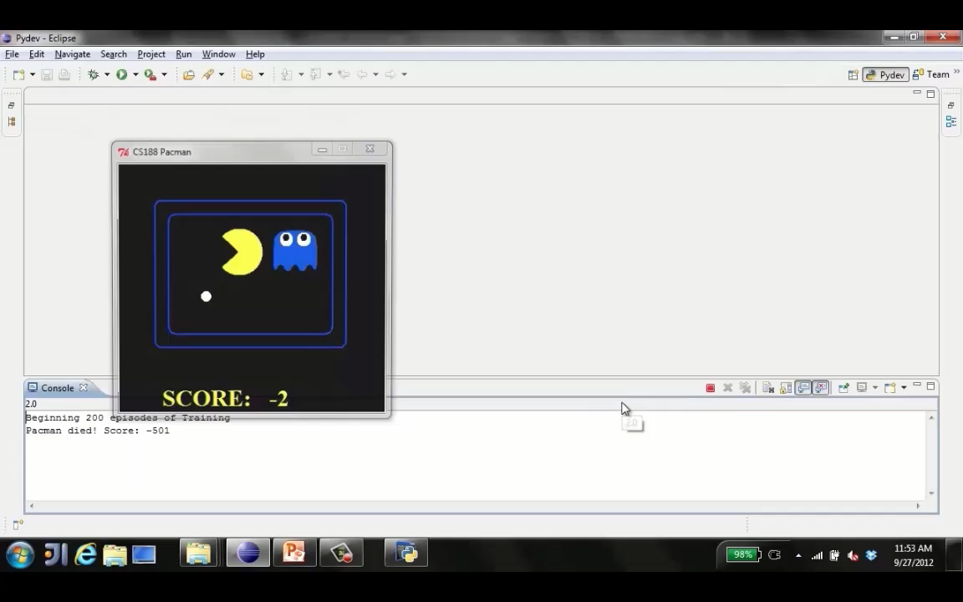
Tiny pacman demo 1
Credit: CS188 – Intro to AI, UC Berkeley, ai.berkely.edu

Slide 61
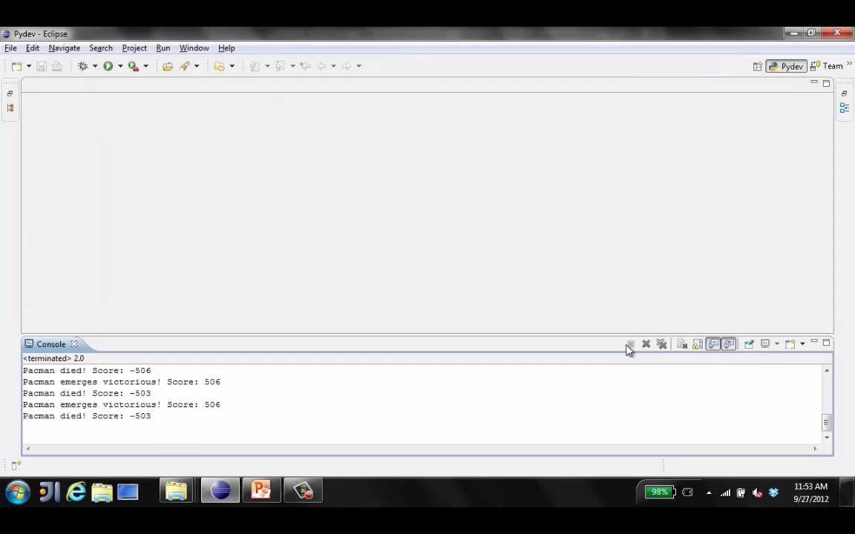
Tiny pacman demo 2
Credit: CS188 – Intro to AI, UC Berkeley, ai.berkely.edu

Slide 62
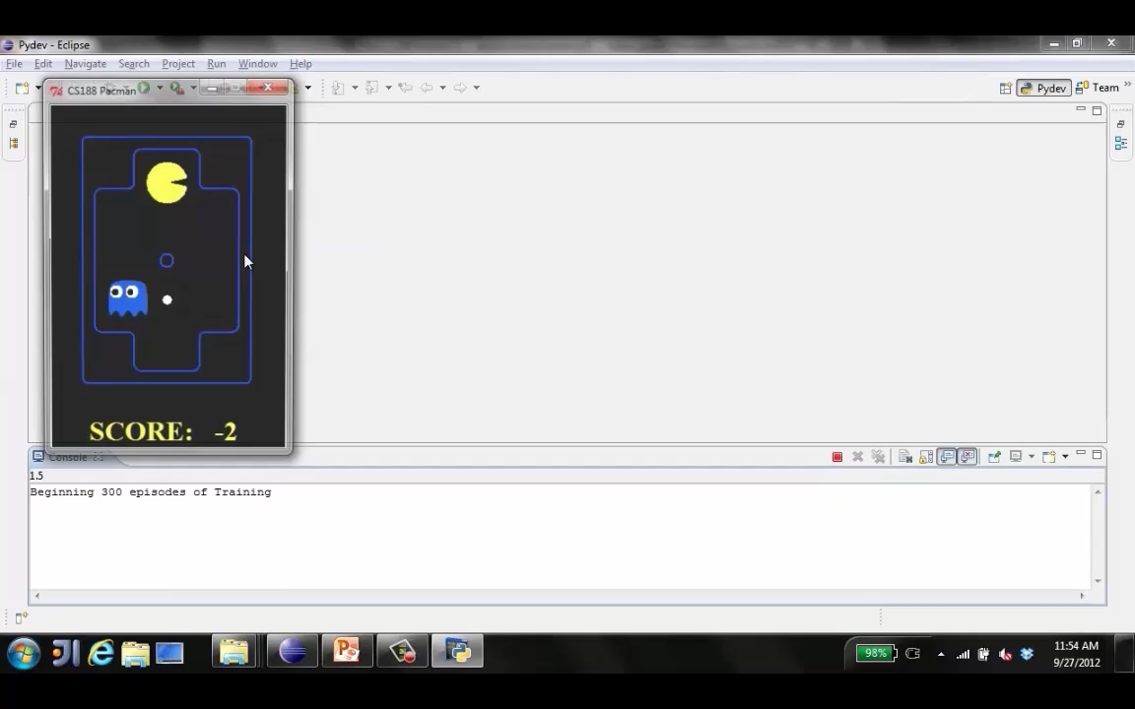
Tiny pacman demo 3
Credit: CS188 – Intro to AI, UC Berkeley, ai.berkely.edu

Slide 63


Feature-Based Representations
Solution: describe a state using a vector of features (properties)
Features are functions from states to real numbers (often 0/1) that capture important properties of the state
Example features:
Distance to closest ghost
Distance to closest dot
Number of ghosts
1 / (dist to dot)²
Is Pacman in a tunnel? (0/1)
…… etc.
Is it the exact state on this slide?
Can also describe a q-state (s, a) with features (e.g. action moves closer to food)
Credit: CS188 – Intro to AI, UC Berkeley, ai.berkely.edu

Slide 64
Linear Value Functions
Using a feature representation, we can write a q function (or value function) for any state using a few weights:
Advantage: our experience is summed up in a few powerful numbers
Disadvantage: states may share features but actually be very different in value!
Credit: CS188 – Intro to AI, UC Berkeley, ai.berkely.edu

Slide 65
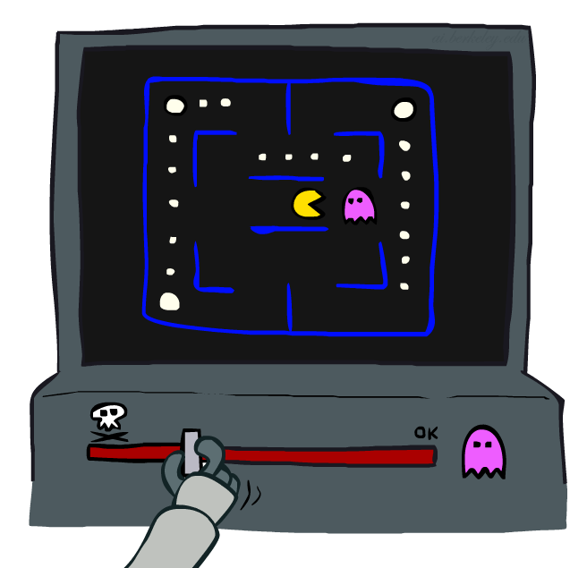
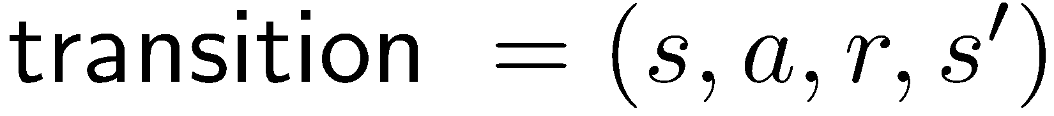
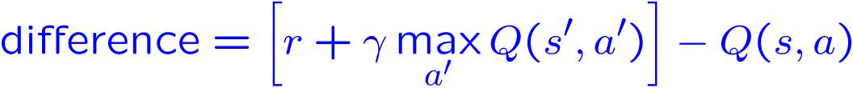
Approximate Q-Learning
Q-learning with linear Q-functions:
Intuitive interpretation:
Adjust weights of active features
E.g., if something unexpectedly bad happens, blame the features that were on i.e., “dis-prefer” all states with that state’s features
Formal justification: online least squares
Exact Q’s
Approximate Q’s
Credit: CS188 – Intro to AI, UC Berkeley, ai.berkely.edu

Slide 66

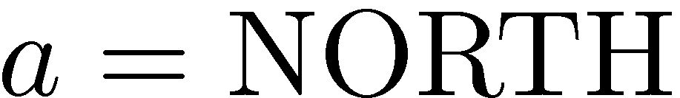
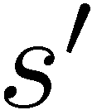

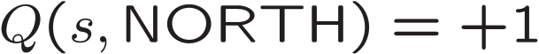
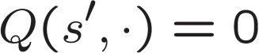
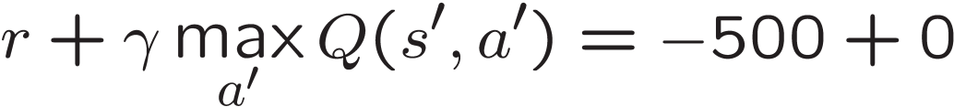
Example: Q-Pacman
Credit: CS188 – Intro to AI, UC Berkeley, ai.berkely.edu

Slide 67
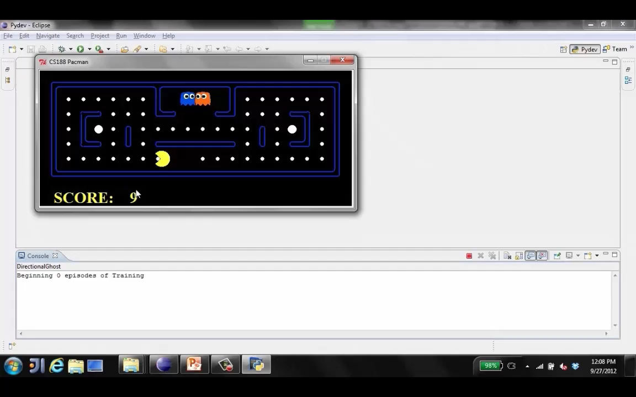
Approximate Q-Learning demo -- pacman
Credit: CS188 – Intro to AI, UC Berkeley, ai.berkely.edu

Slide 68
Next Time: More RL
Possible Topics:
More about Generalization
SARSA – Online Learning vs Offline learning (Q-Learning)
Partially Observable Markov Decision Processes (POMDPs)
Deep Q-Learning

